Slide 1
College Enrollment System
Chekuri Divya
Dinesh Singh
4/4 B.Tech
Information Technology
GIT,Gitam University

Slide 2
Introduction
College Enrollment is the web application where user can register in to the college online. Here user can register very easily and quickly by filling the registration from with normal personal details like name, address, email id, phone number, academic details. And after registration user can check weather registration is completed or not. And user can see the information about all pre-registered students.
The register ID will include the details about user like department code, admitted tear college code, his no in the branch registration.
Administrator will load the information about the departments and no: of seats per department.

Slide 3
Proposed System
It is very difficult for college administration to enroll candidates manually. And people in other cities will take time to register so it is better to have an online registration for the college.
The college administrations only have to load their college’s department details into the application. Then students can register online. The University’s has to make a shared Database with our Web-App so that web-app could easily access and store the data in the University’s Database and respective universities or administrators of College Enrolment System can access and modify.

Slide 4
Hardware Requirements
Input Devices: Keyboard and Mouse
RAM: 2 GB
Processor: dual core or above
Storage: Less than 10 GB of HDD space and DataBase.
Networking: 1mbps net speed either by lan or wifi

Slide 5
Software Requirements
Operating System: Mac OSX 10.8 or windows 7 sp 2
Run-Time: Java Virtual Machine
Apache tomcat server or Glass Fish Server
MySQL database

Slide 6
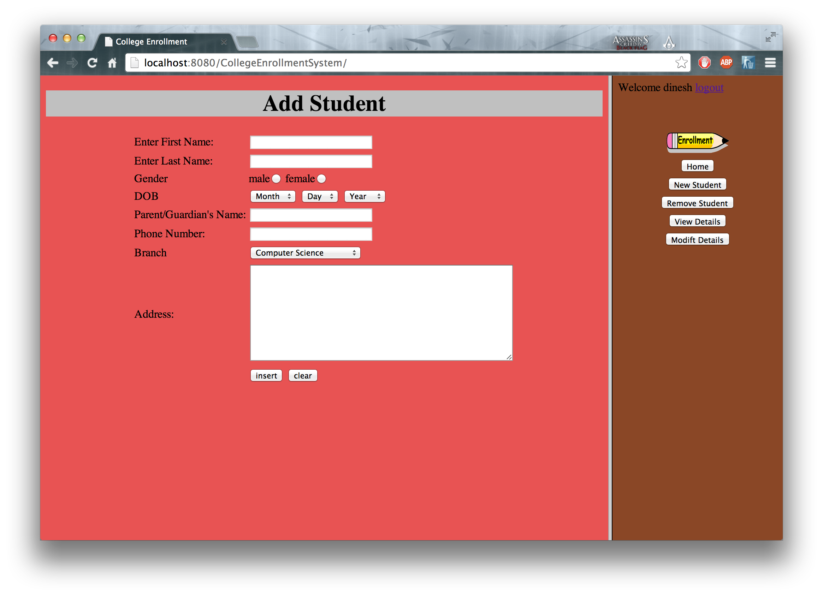

Slide 7
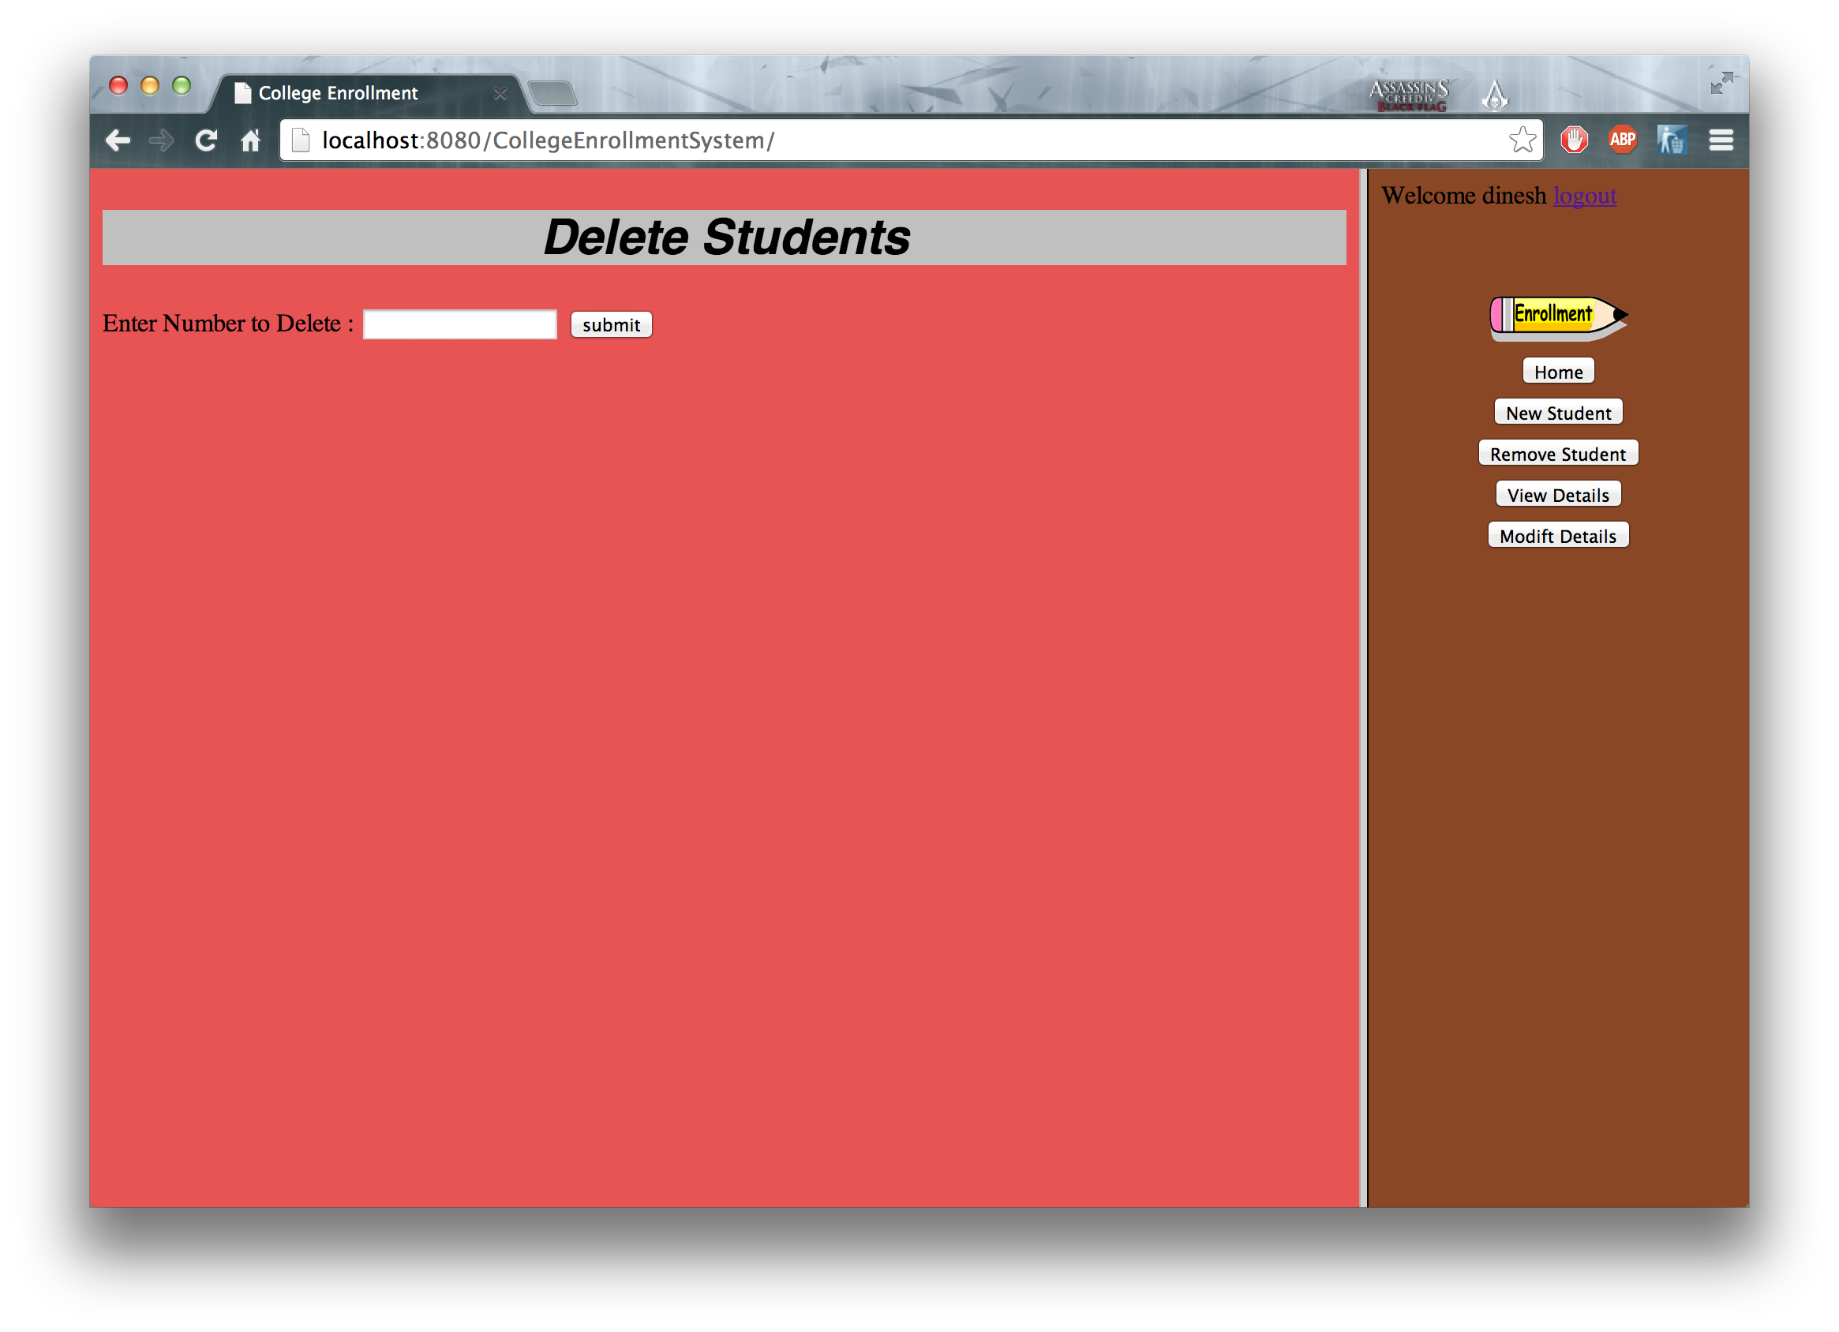

Slide 8
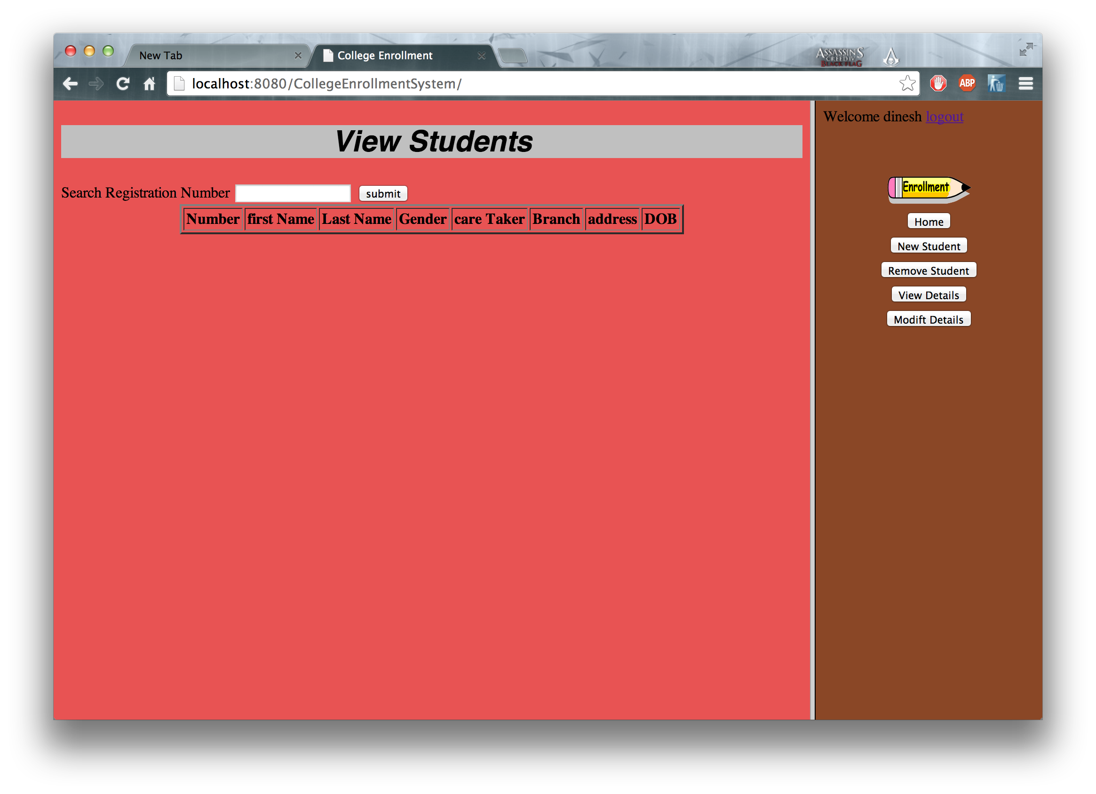
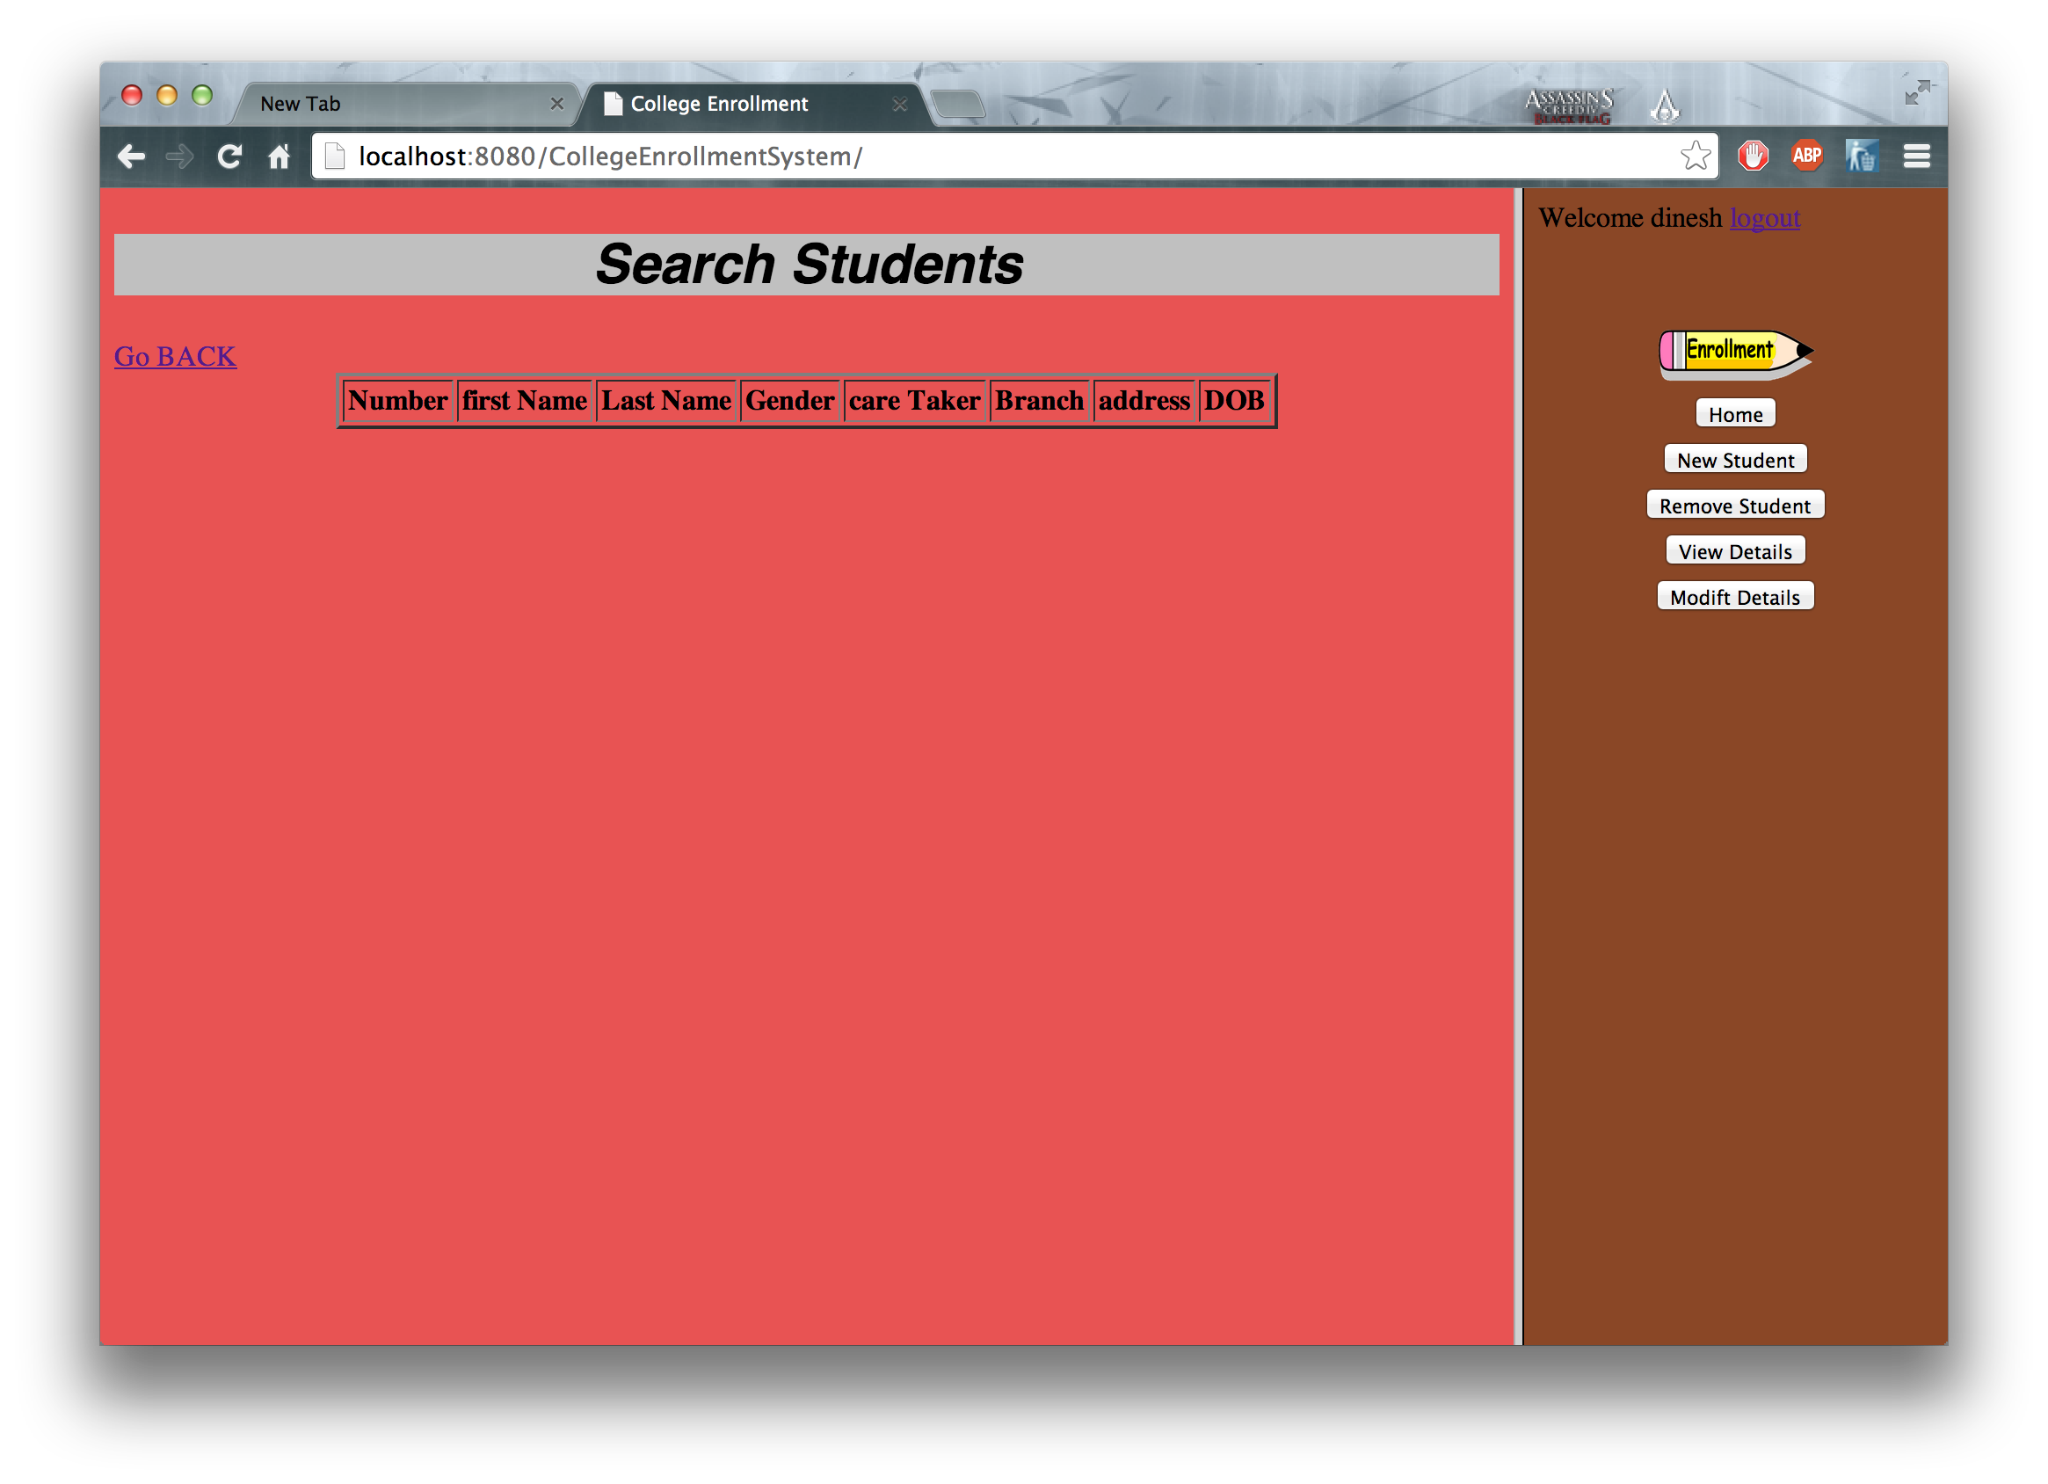

Slide 9
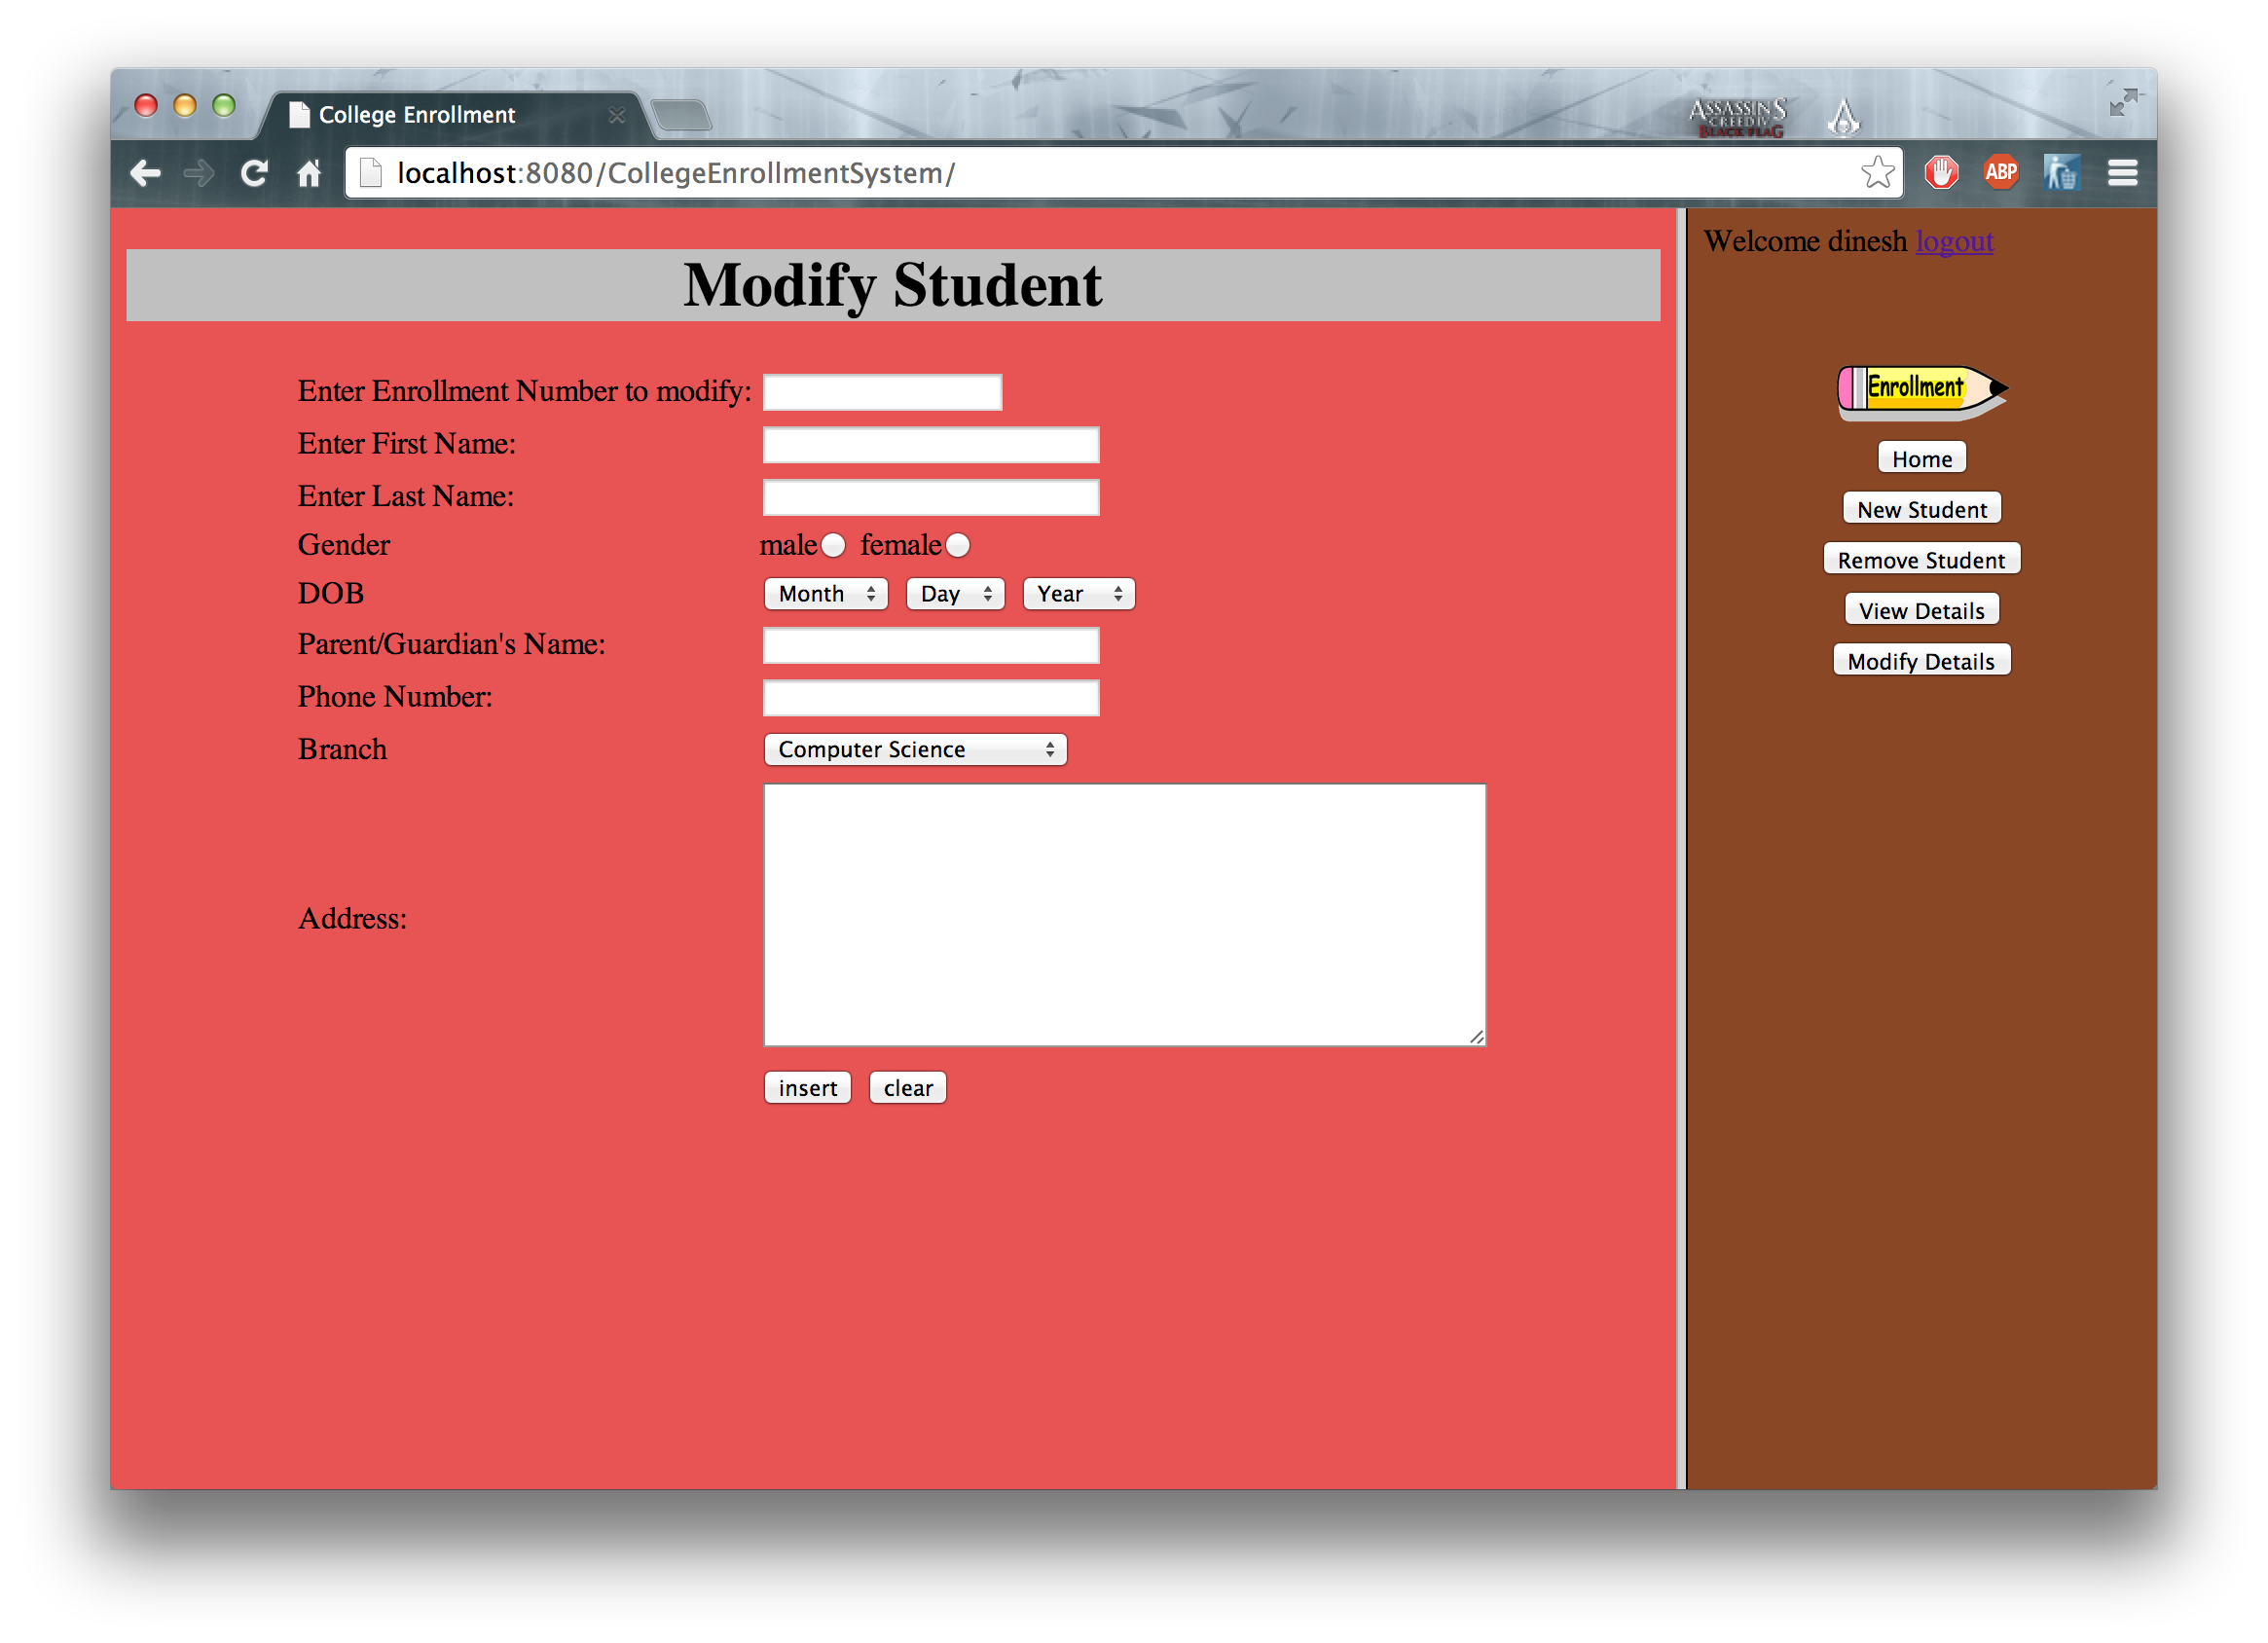

Slide 10
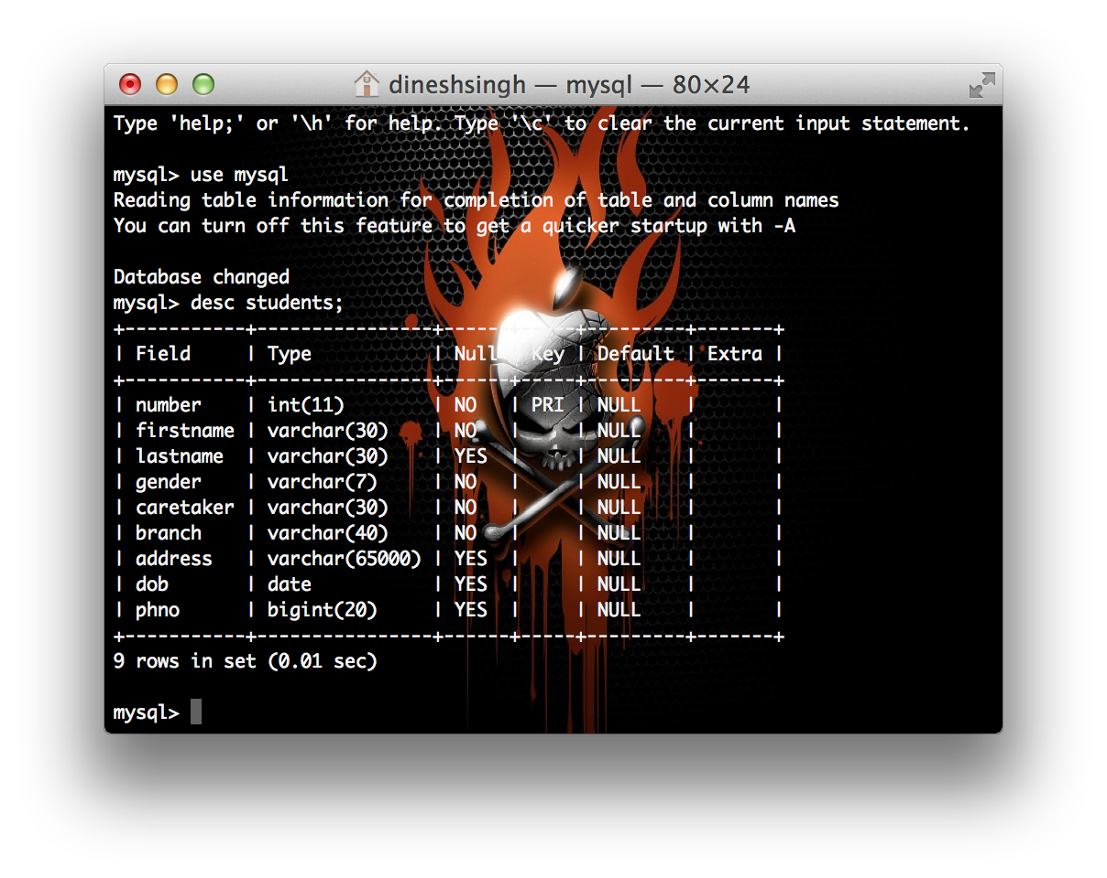
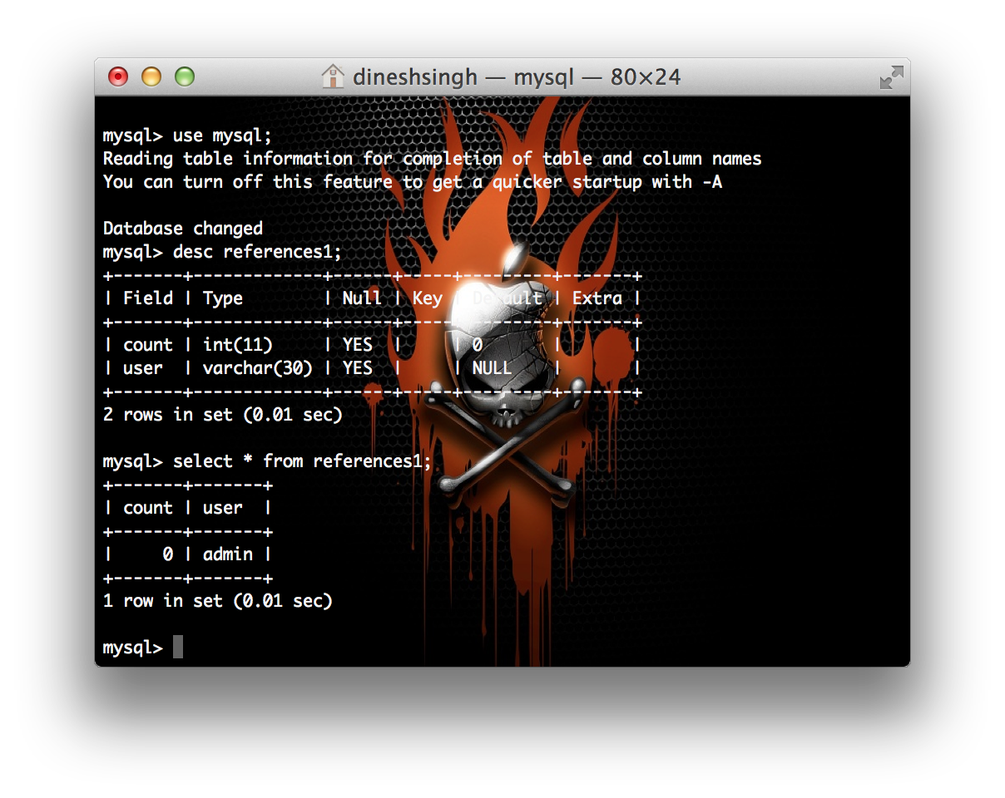

Slide 11
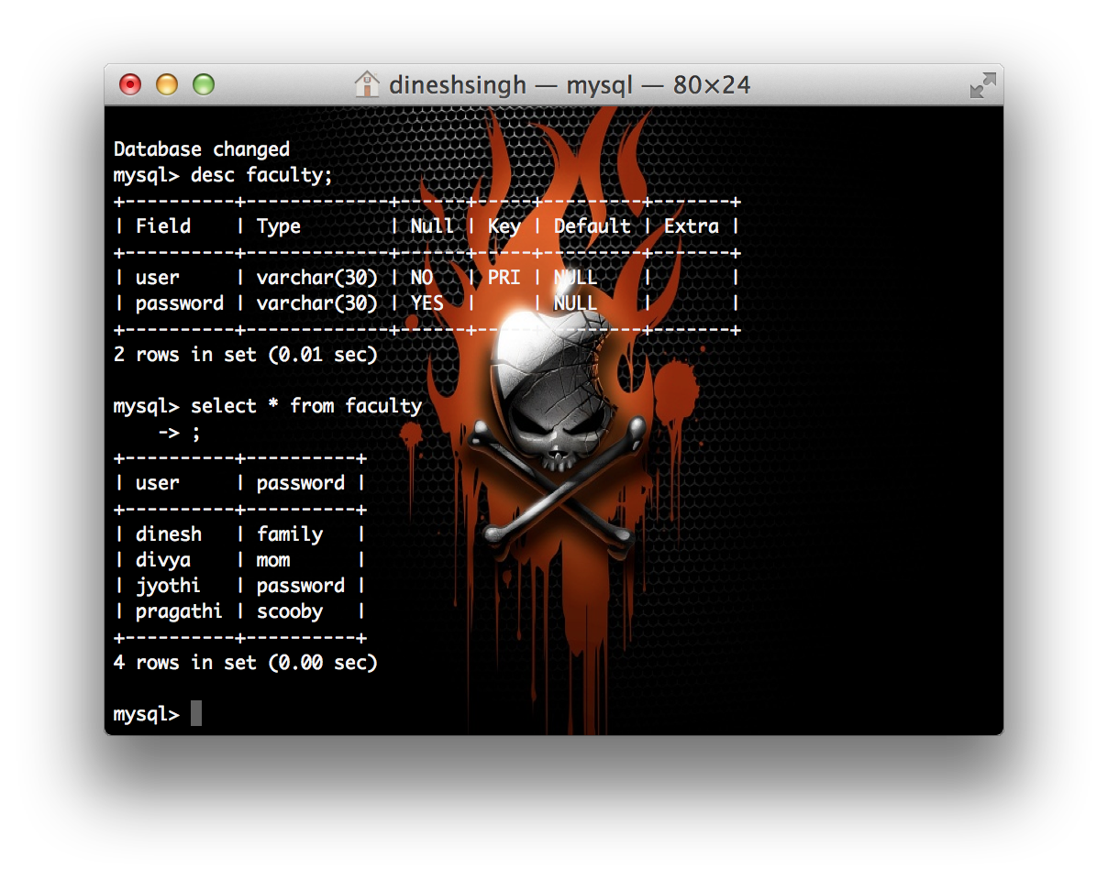
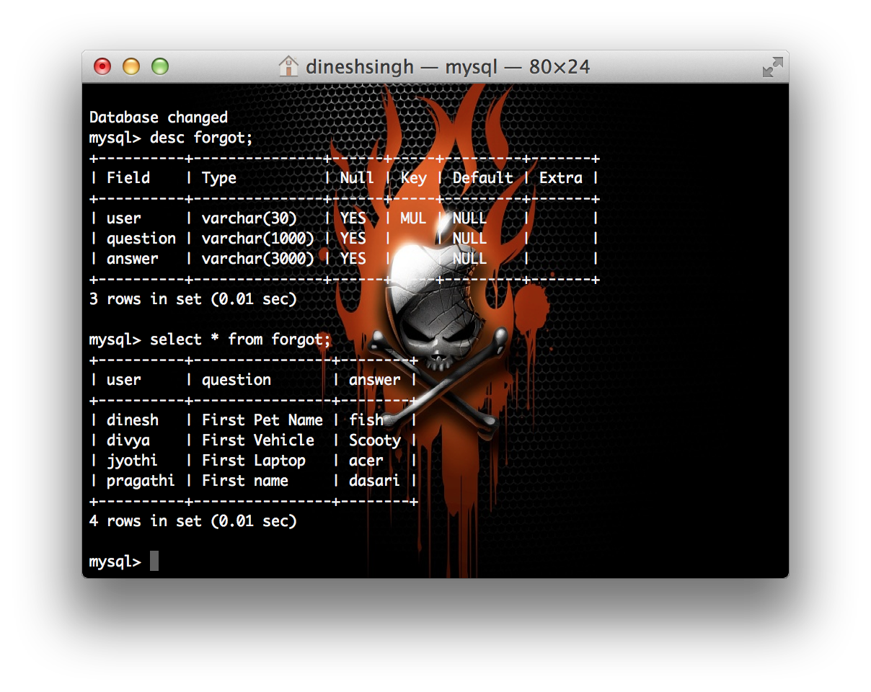

Slide 12
Thank You

